Slide 1
PnP Community Call – October 2014
aka.ms/OfficeDevPnP
aka.ms/OfficeDevPnPYammer
PnP Core Team

Slide 2




Agenda
Introduction
Contributions and process
Other topics
Roadmap and next steps

Slide 3
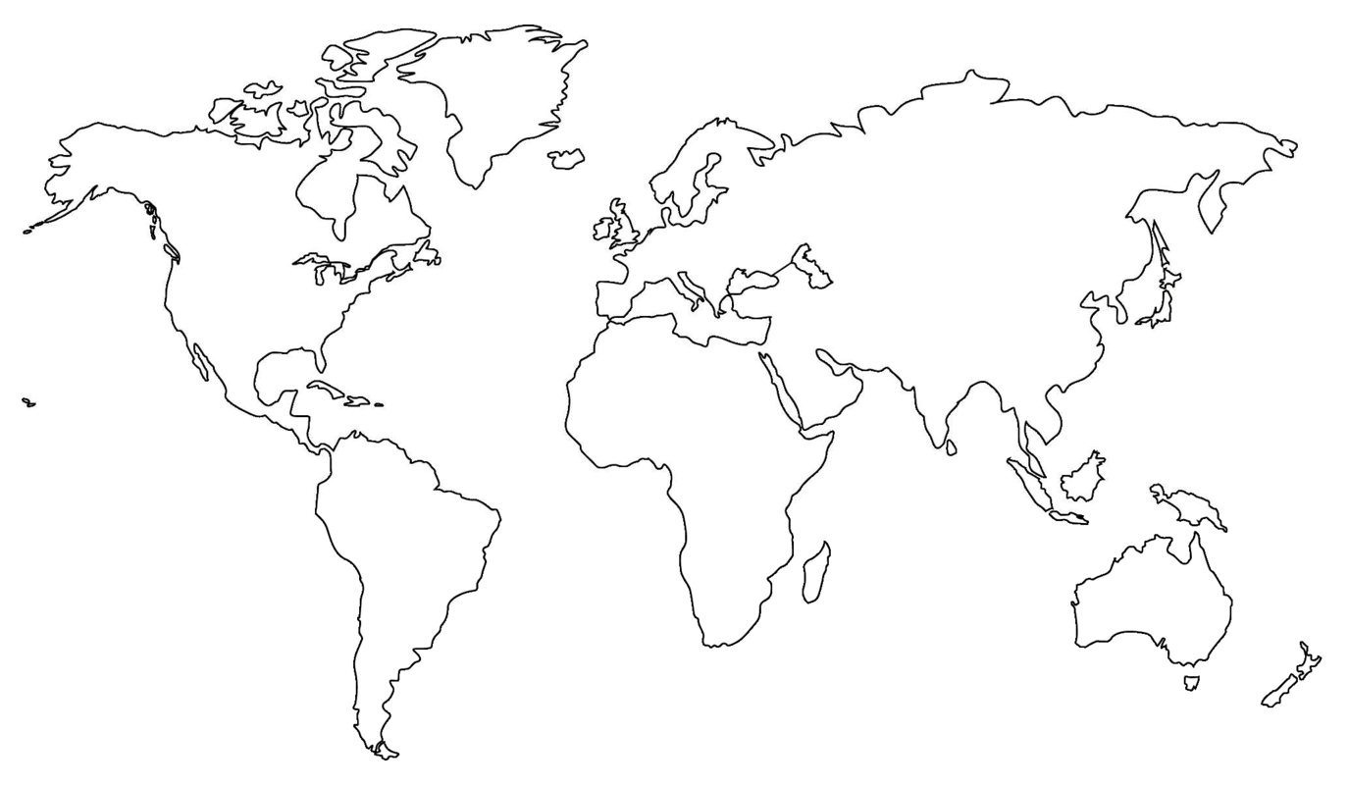
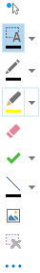
Where are you located?
Stamp Tool
Notes:
Length: 2 minutes for this slide
This slide is a quick demo/practice of the “Stamp” tool and how to use it during course interactions.
Have students Check where they live.
If it’s a small class, have students type their name where they live.
Reach out to the farthest away student

Slide 4


Developer
Patterns & Practices
aka.ms/OfficeDevPnP
aka.ms/OfficeDevPnPYammer

Slide 5
Statistics– Key numbers
Forked 98 times
128 merged pull requests
29 closed issues
More than 1899 unique visitors during last 2 weeks
Yammer group has 587 members
From 416 in September
aka.ms/OfficeDevPnPYammer

Slide 6
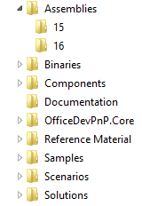
PnP Structure – folders and code
All referenced assemblies are included in package.
Contains latest 15 & 16 versions of the CSOM components.
No need for additional downloads
Reusable components targeted for reuse as such in projects.
Various Presentations on different scenarios.
Reusable remote operation component with extensions methods to standard CSOM objects.
Sample projects. Independent samples demonstrating a capability or functionality.
Scenario demonstrations for the usage of the core component. Contains additional explanations and usage models for API patterns.
Complex reusable solutions demonstrating combining multiple capabilities for building real solution. Uses core component.

Slide 7

Key contributors this period
Thank you for your assistance!
Erwin Van Hunen (Knowit AB) - @knowsharepoint
Sly Gryphon (Readify) - sgryphon
Henrik Gustafsson
Andrei Markeev
Johan Skårman
Core team – Frank Marasco, Bert Jansen, Vesa Juvonen,
Brian Michely, Suman Chakrabarti

Slide 8
New solutions
Core.JavaScriptInjection.WeekNumbers (Johan Skårman , MSFT)
Core.RibbonCommands (Suman Chakrabarti , MSFT)
Workflow.AssociateToHostWeb (Frank Marasco, MSFT)
Branding.ClientSideRendering extension: dependent fields CSR extension (Andrei Markeev)
OD4B.NavLinksInjection (Brian Michele , MSFT)
AzureAD.GroupMembership (Bert Jansen , MSFT)

Slide 9
Updates to PnP Core and miscellaneous
Lots of refactoring, updates and improvements done by Erwin Van Hunen and Sly Gryphon:
Default value handling (Erwin van Hunen)
Termset import (Sly Gryphon)
Support for publishing pages (Henrik Gustafsson)
Additional unit tests ➔ 104 unit tests available!
SAML support (SharePoint + ADFS)
V15 support for PnP core library
V15 support for PowerShell.Commands
Binary installer for PowerShell.Commands
Binaries folder to make it easy to fetch binaries of a release

Slide 10
Master merge
We are planning to perform master merge next week to sync up things
More detailed testing will be done before this one
In general we are moving to monthly master branch releases from this moment forward

Slide 11
How to contribute?
Documentation in wiki
https://github.com/OfficeDev/PnP/wiki/contributing-to-Office-365-developer-patterns-and-practices
Simple steps
Fork
Apply changes and contributions
Submit a pull request
Core team members will review
Merged to Dev

Slide 12

Roadmap – What’s coming?
New patterns for SP side
WebAPI services
More complex solution scenarios
Office client and JSOM patterns
Improvements to core component
Nuget package
Unit testing, logging, other stuff
Guidance
Application Life Cycle for app model
Design patterns for App model based implementation
Transformation guidance for existing customizations
App model impact for enterprise architecture
Content migration for app model implementation
Continuous integration

Slide 13
Feedback…
Please keep the feedback coming in Yammer… we need your input for the prioritization.
Notes:
Priority on planned topics
More code samples
Add core component capabilities
Reusable presentation material
Documentation on patterns and practices for app model (ALM ec.)
More complex solutions
More Office Client apps
More JavaScript app
Length: 30 second for this slide
Instructor notes
The following slides will walk you though the Lync tools that we will use in this class.
You will use all of these tools later in the class
Stress that your students will be able to run much more engaging meetings if they use these tools in their own Lync Meetings.
Course Development Notes:

Slide 14
Transform your code Providing App Model Patterns for common Full Trust Code scenarios
50+ Visual Studio projects Common scenarios
Branding
Site provisioning
Remote event receivers
Large file support
Taxonomy driven navigation
And much more…
Contribute
This is open source project and open for contirbutions
Developer
Patterns & Practices
aka.ms/OfficeDevPnP

Slide 15

Questions?

Slide 16


© 2014 Microsoft Corporation. All rights reserved. Microsoft, Windows, and other product names are or may be registered trademarks and/or trademarks in the U.S. and/or other countries.
The information herein is for informational purposes only and represents the current view of Microsoft Corporation as of the date of this presentation. Because Microsoft must respond to changing market conditions, it should not be interpreted to be a commitment on the part of Microsoft, and Microsoft cannot guarantee the accuracy of any information provided after the date of this presentation. MICROSOFT MAKES NO WARRANTIES, EXPRESS, IMPLIED OR STATUTORY, AS TO THE INFORMATION IN THIS PRESENTATION.

